Slide 1
Co2 Emission Prediction

Slide 2
Methodology
Looked for Null and Duplicate values and dropped null and duplicate values
Doing Exploratory Data Analysis
Applying Stochastic Gradient Decent Regression and Checking Assumptions
Applying PCA and performing KNN with brute force algorithm.

Slide 3
Exploratory Data Analysis

Slide 4
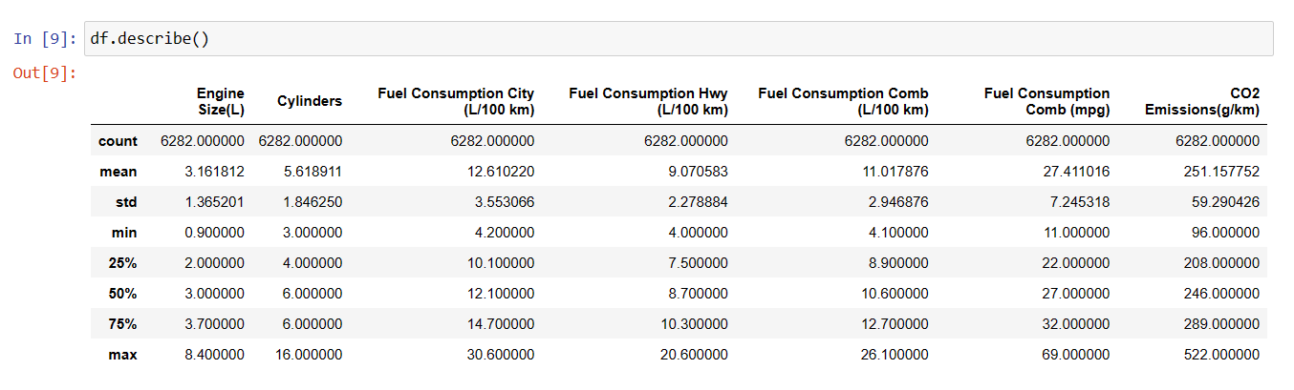

Slide 5
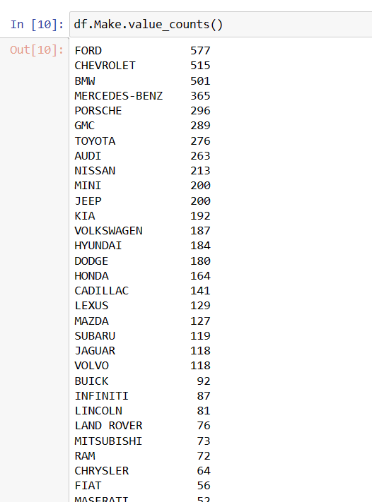
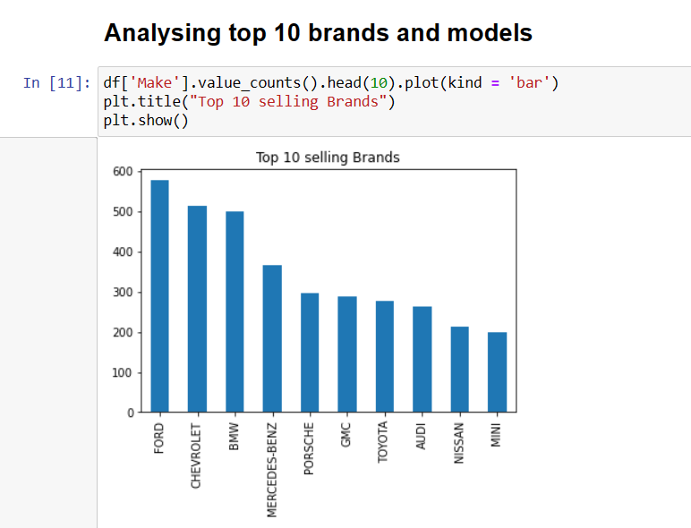

Slide 6
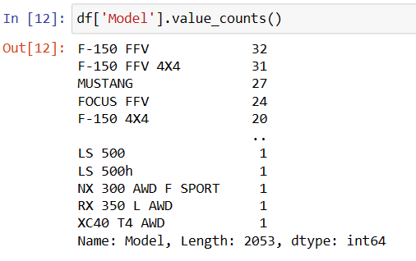
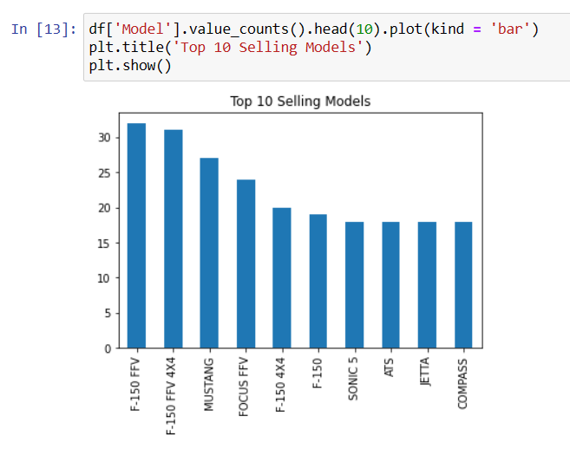

Slide 7
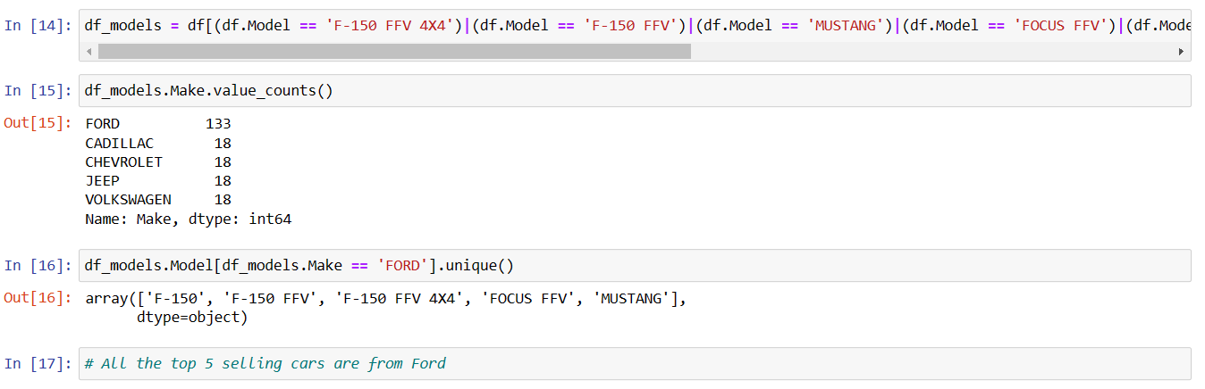

Slide 8
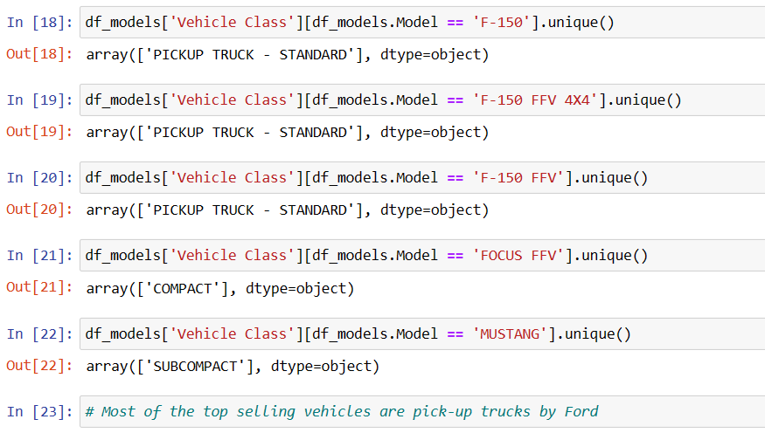

Slide 9
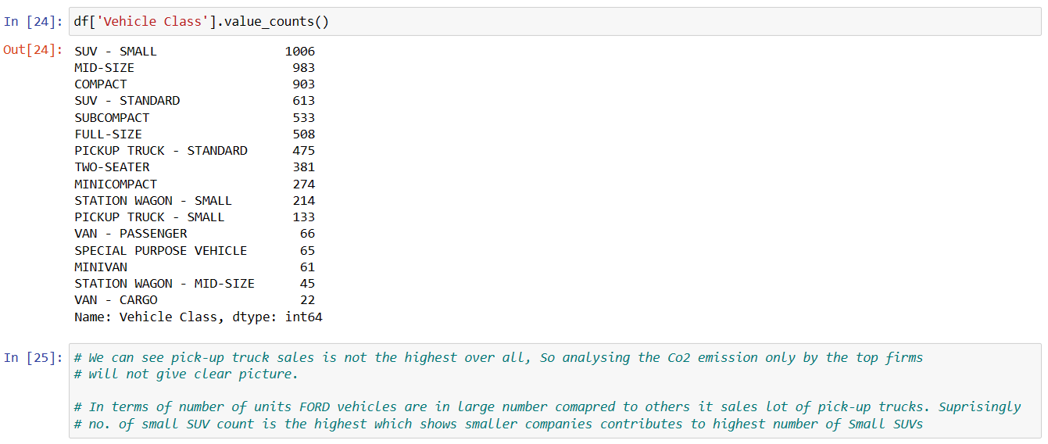

Slide 10
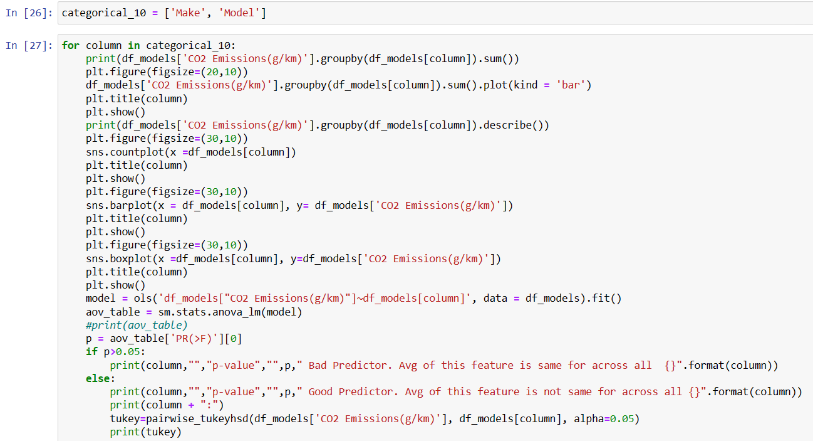

Slide 11
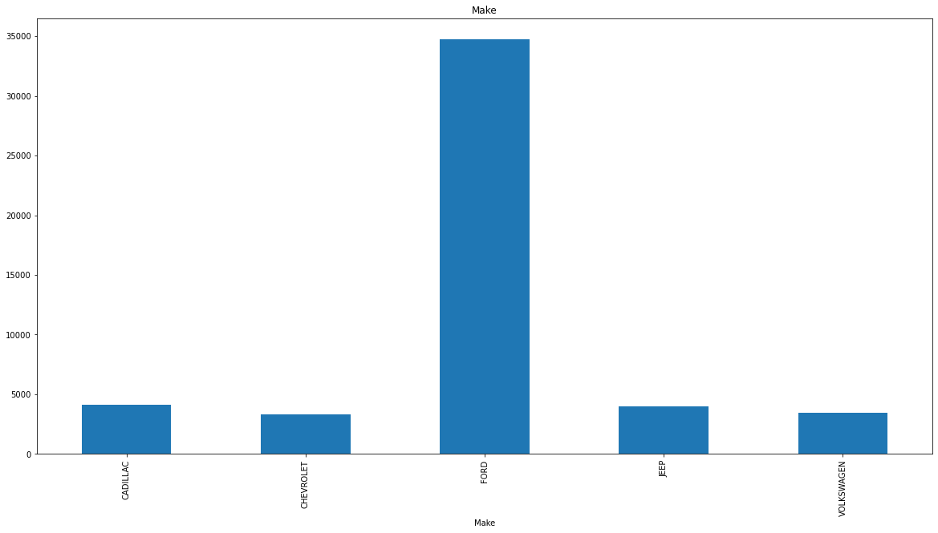
Make CADILLAC 4097 CHEVROLET 3338 FORD 34756 JEEP 3997 VOLKSWAGEN 3470 Name: Total CO2 Emissions(g/km)

Slide 12
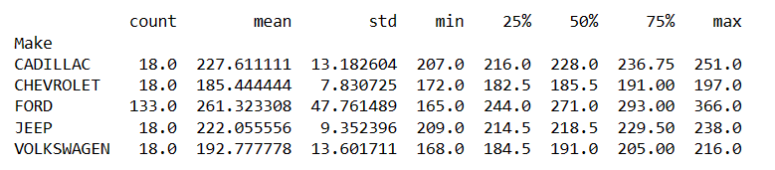
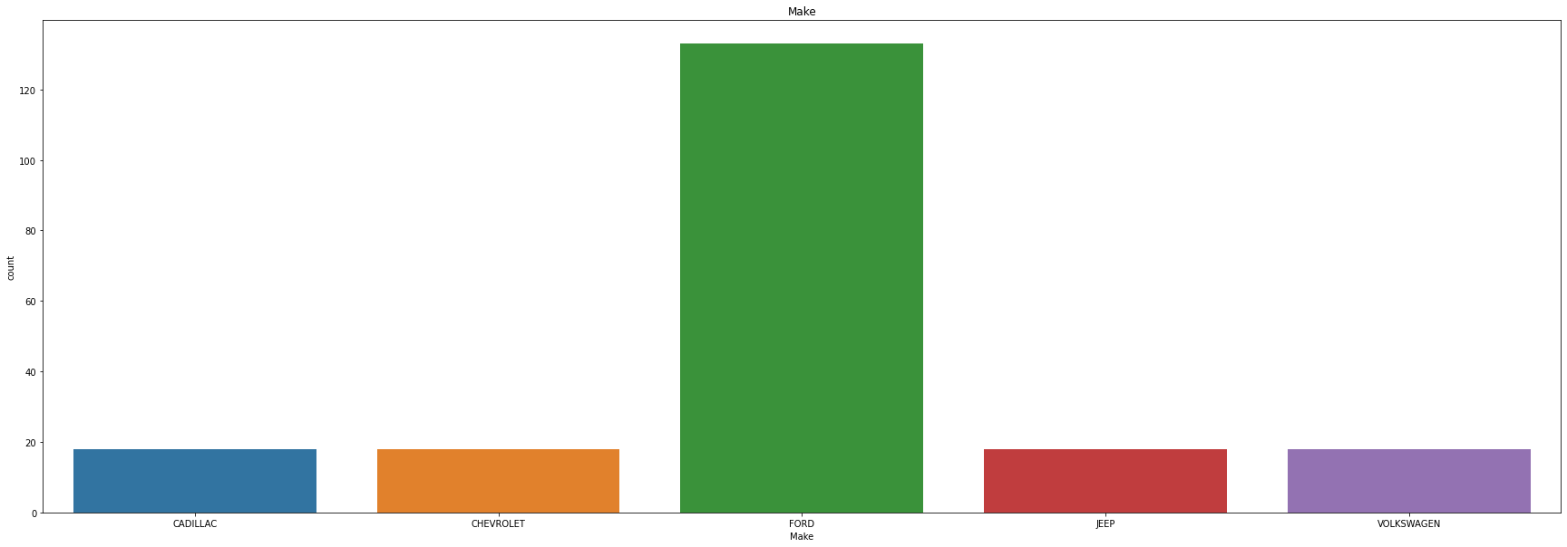

Slide 13
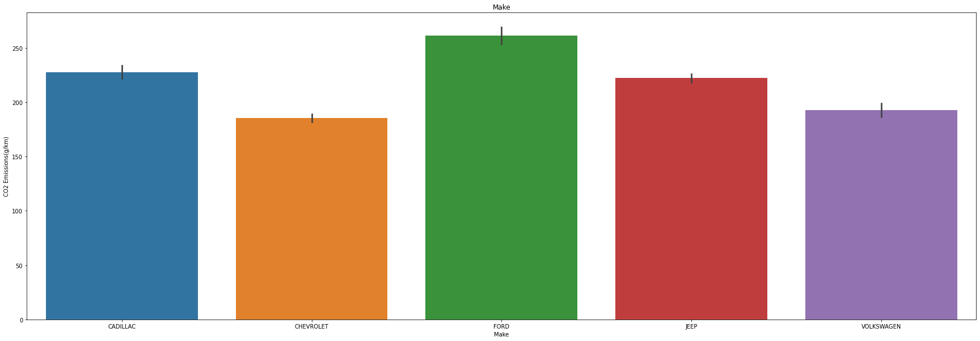
Avg. Co2 Emission

Slide 14
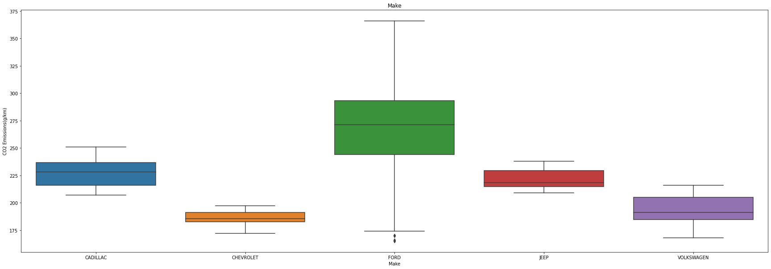
Avg. Co2 Emission

Slide 15
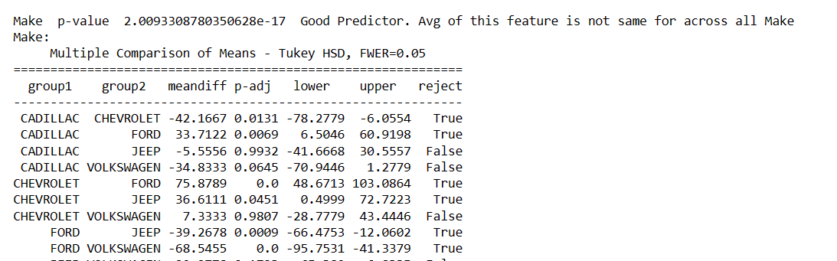

Slide 16
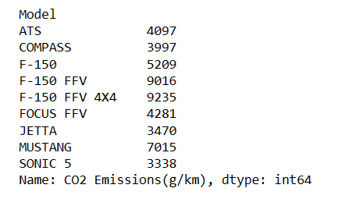
Total Co2 Emission by Car Models

Slide 17
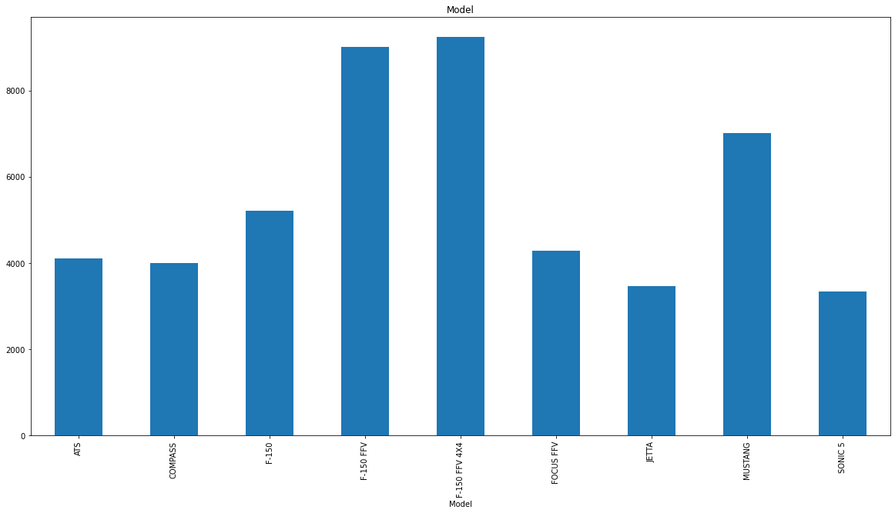

Slide 18
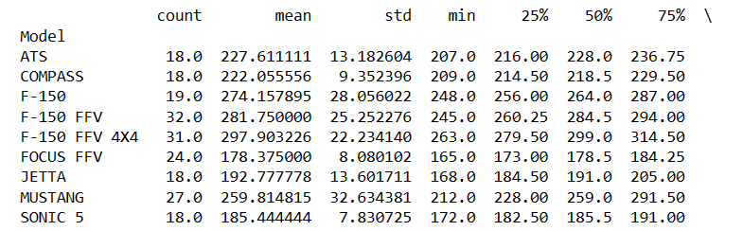
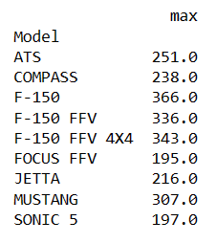

Slide 19
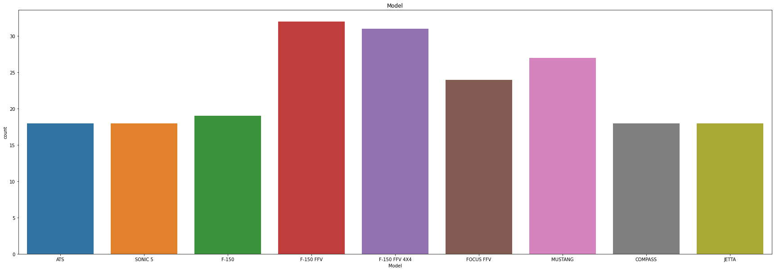

Slide 20
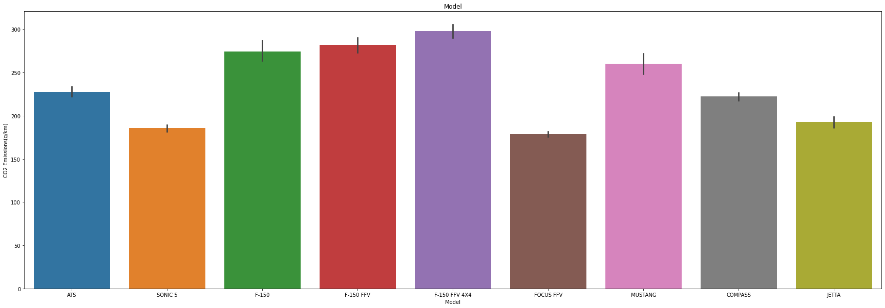

Slide 21
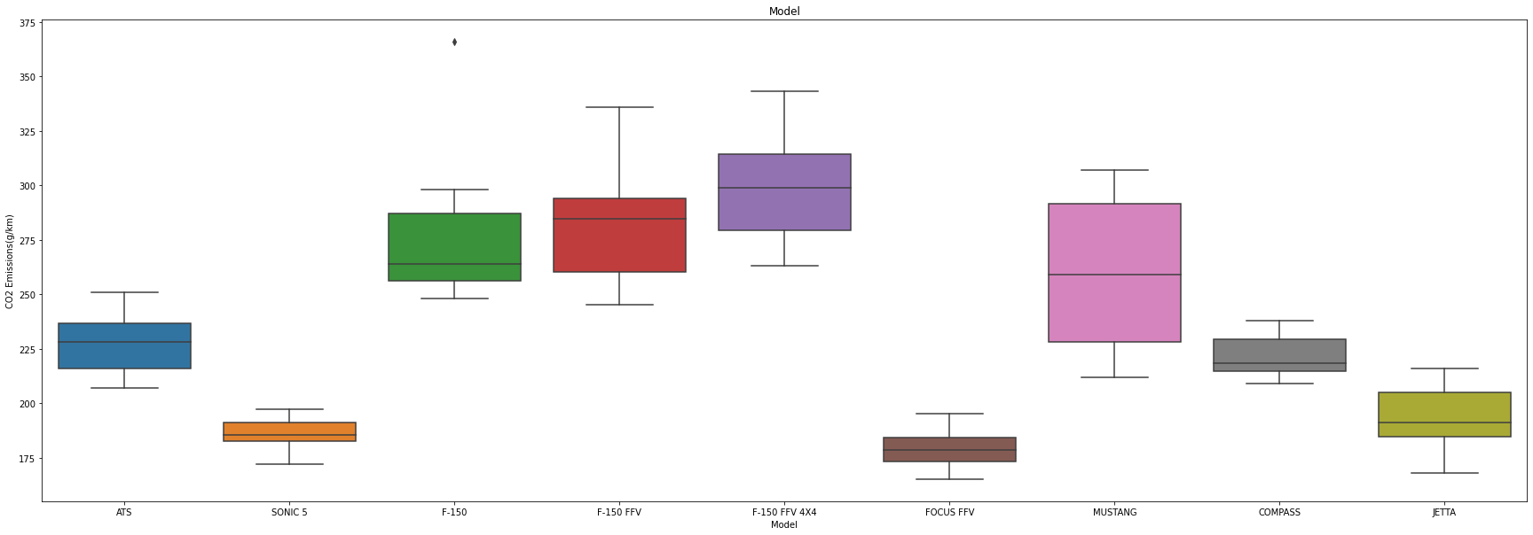

Slide 22
# Make
# Count of Ford is significantly higher so overall Co2 Emission by Ford is also higher
# From bargraph and boxplot we can see, Avg. Co2 Emission by by the top 10 brands is also having a small range, Slight deviation is present because of the mix of class
# of vehicles sold by the brands
# Model
# F-150 FFV, F-150 FFV 4X4, Mustang is having highest Co2 Emission in total
# Similar pattern in countplot justifies the same.
# Jetta, Focus FFV, Sonic 5 have less Co2 emission compared to other models

Slide 23
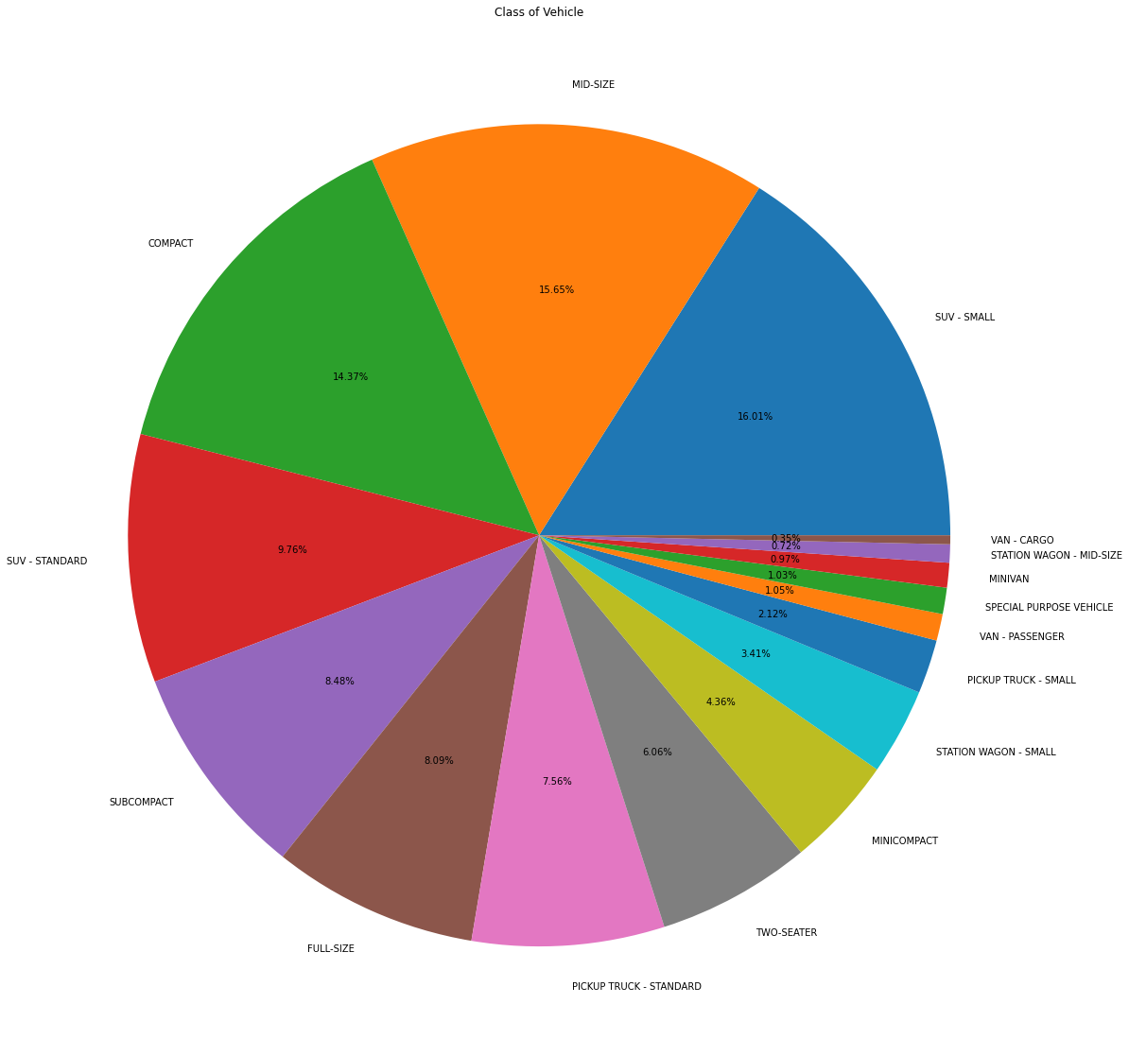

Slide 24
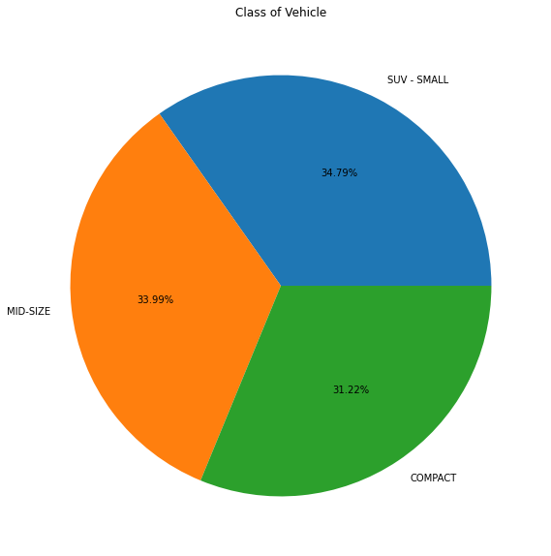
# Cars that are sold majorly are Small SUV, Mid Size and Compact Cars

Slide 25
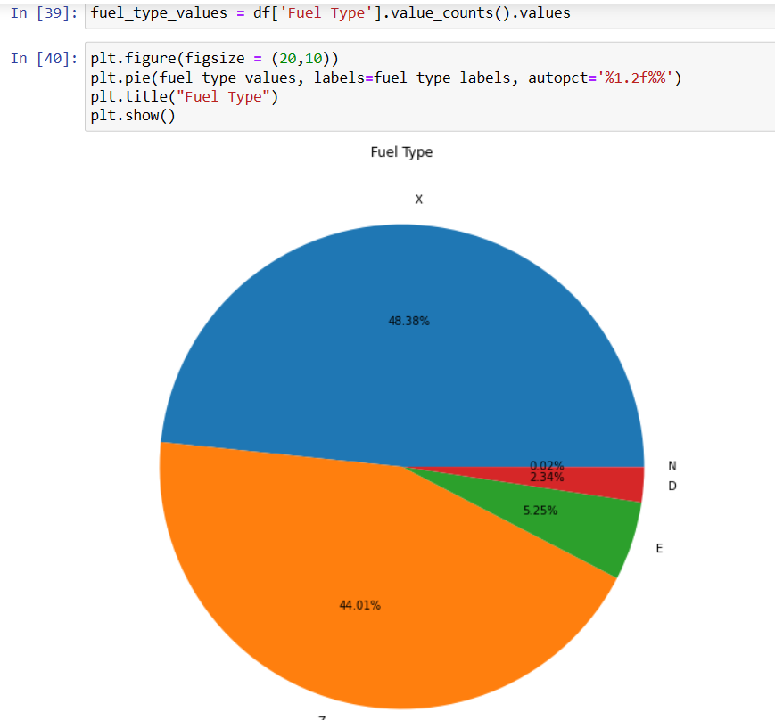
# X and Z are the major fuel type sold

Slide 26
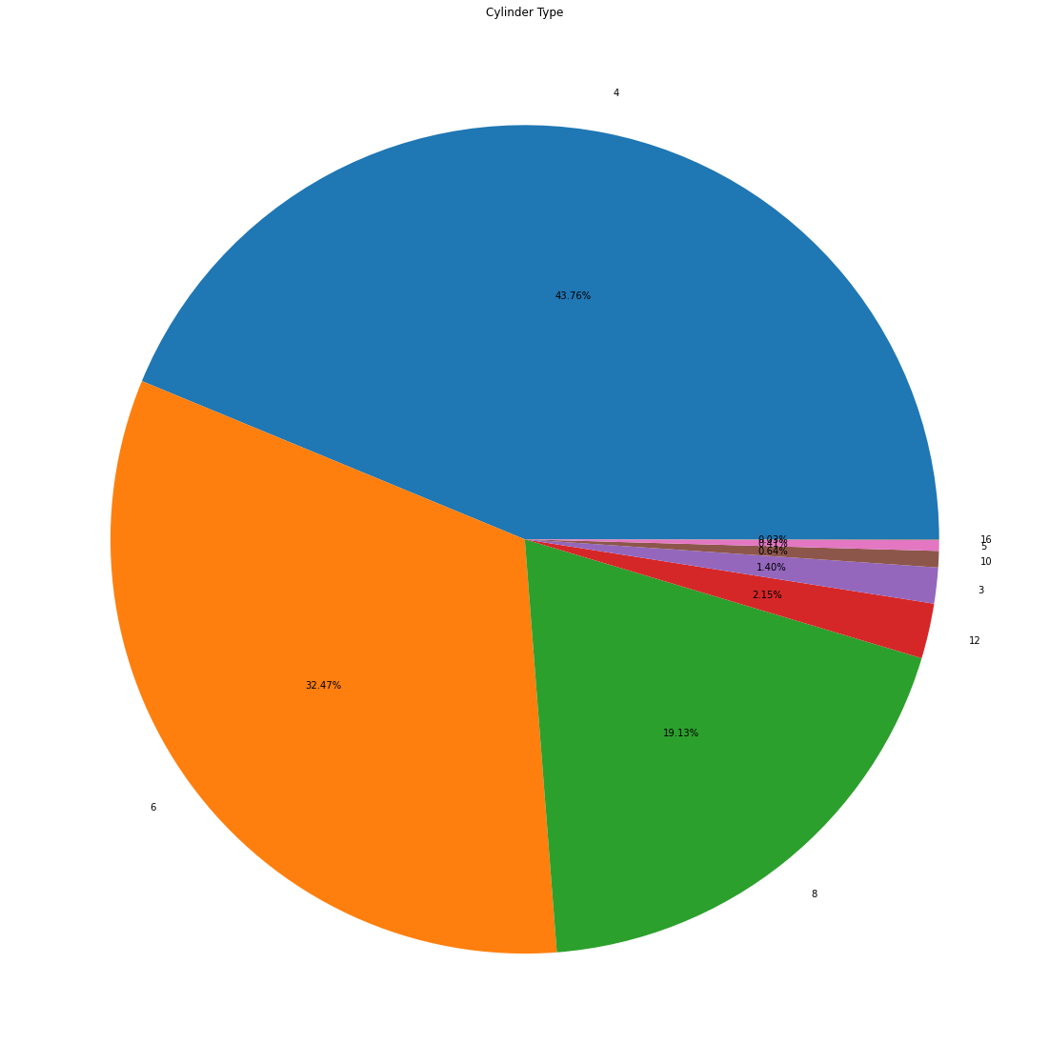

Slide 27
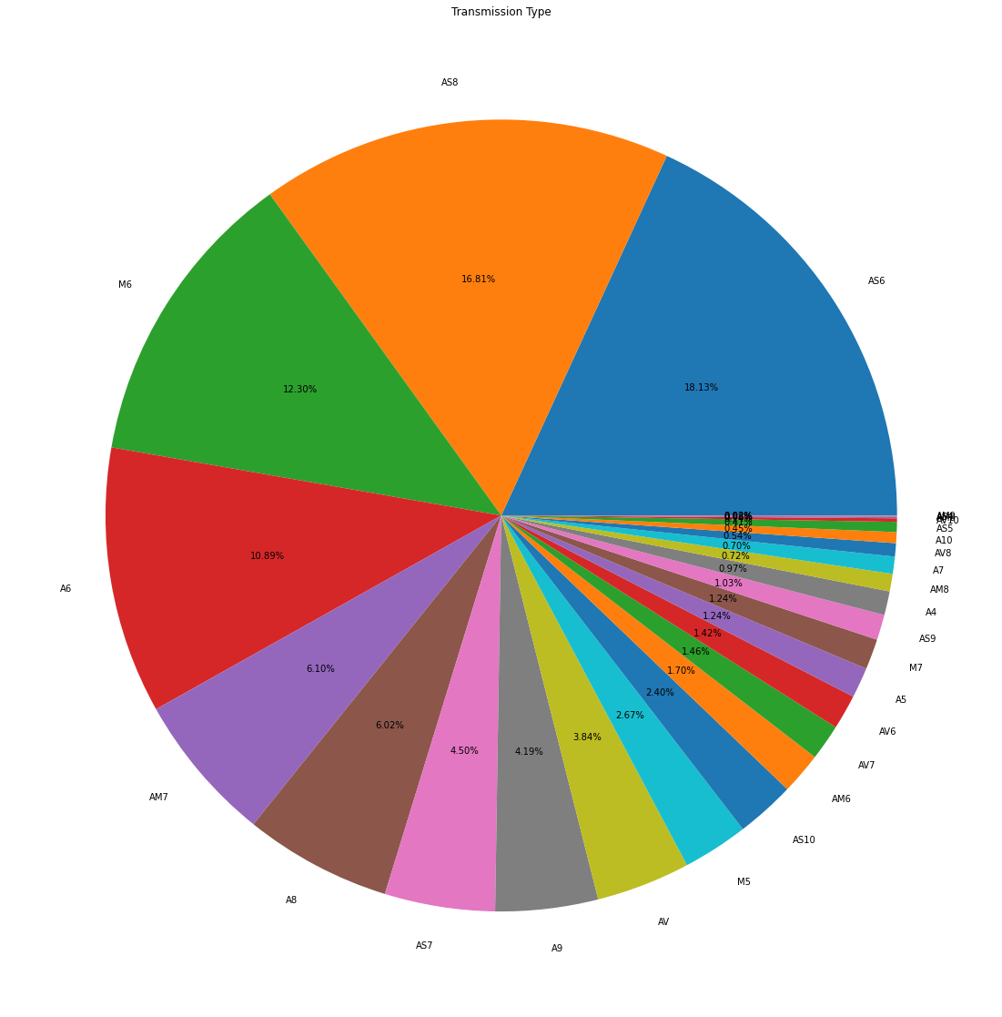

Slide 28
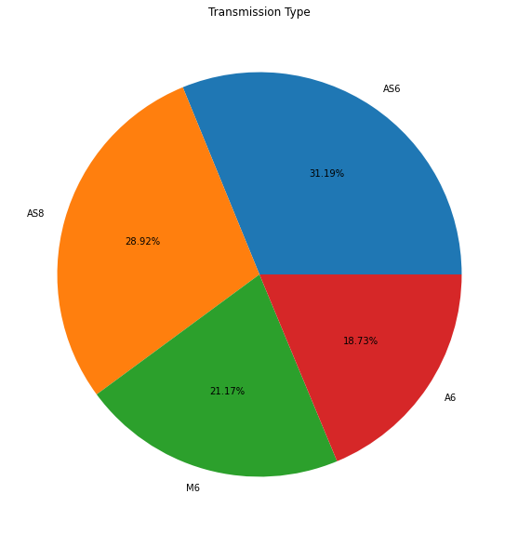

Slide 29
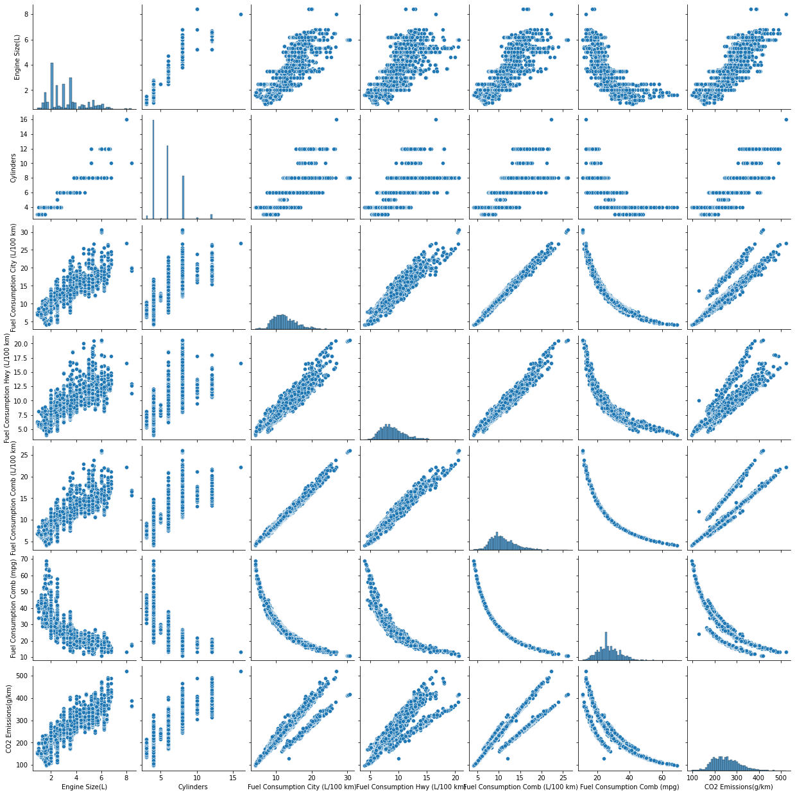

Slide 30
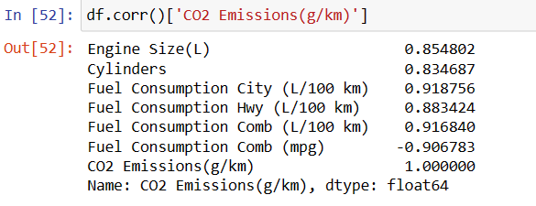
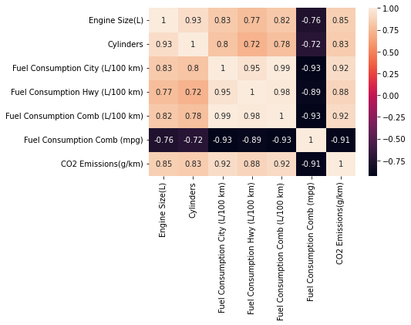

Slide 31



Slide 32
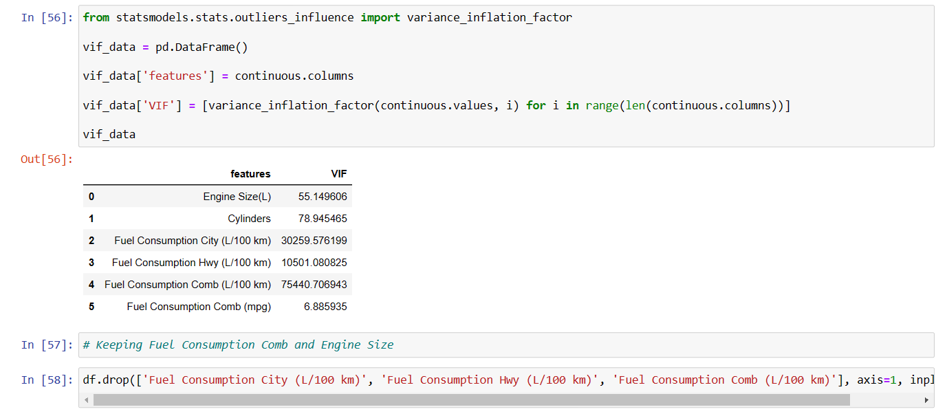

Slide 33
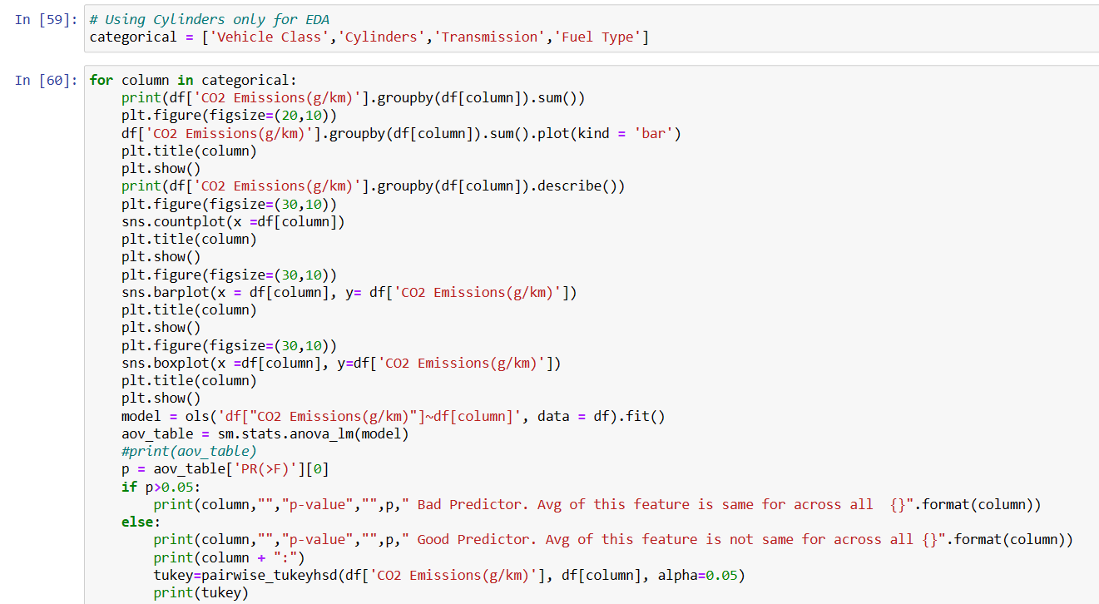

Slide 34
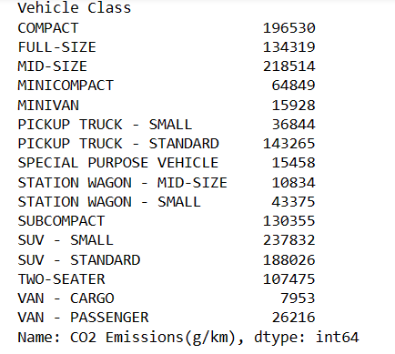
Total Co2 Emission by Vehicle Class

Slide 35
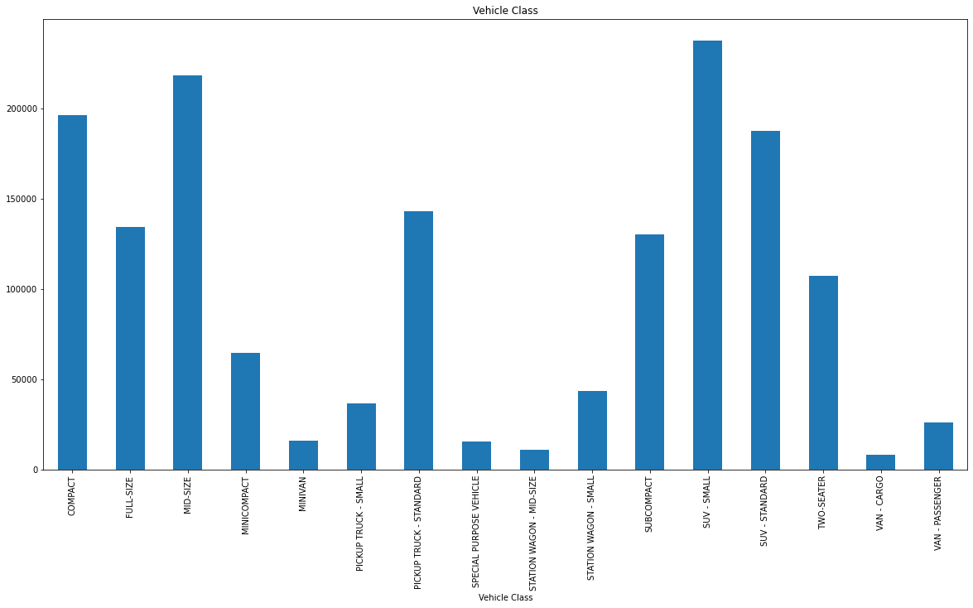

Slide 36
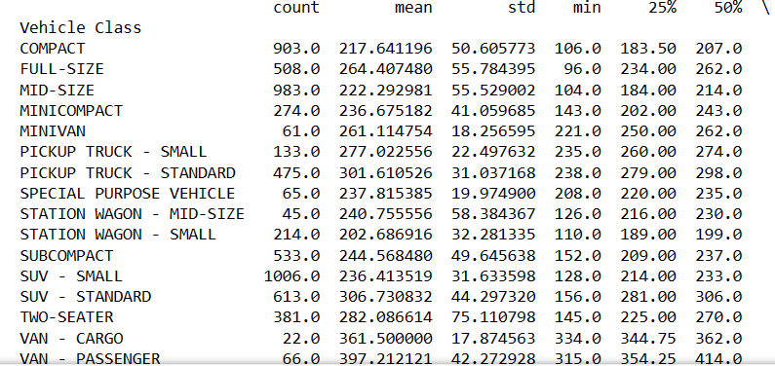
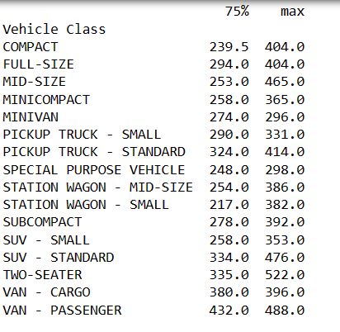

Slide 37
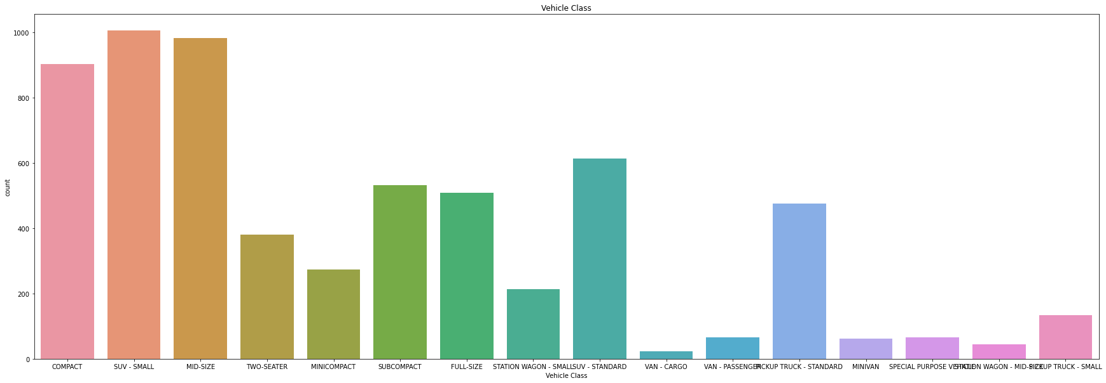

Slide 38
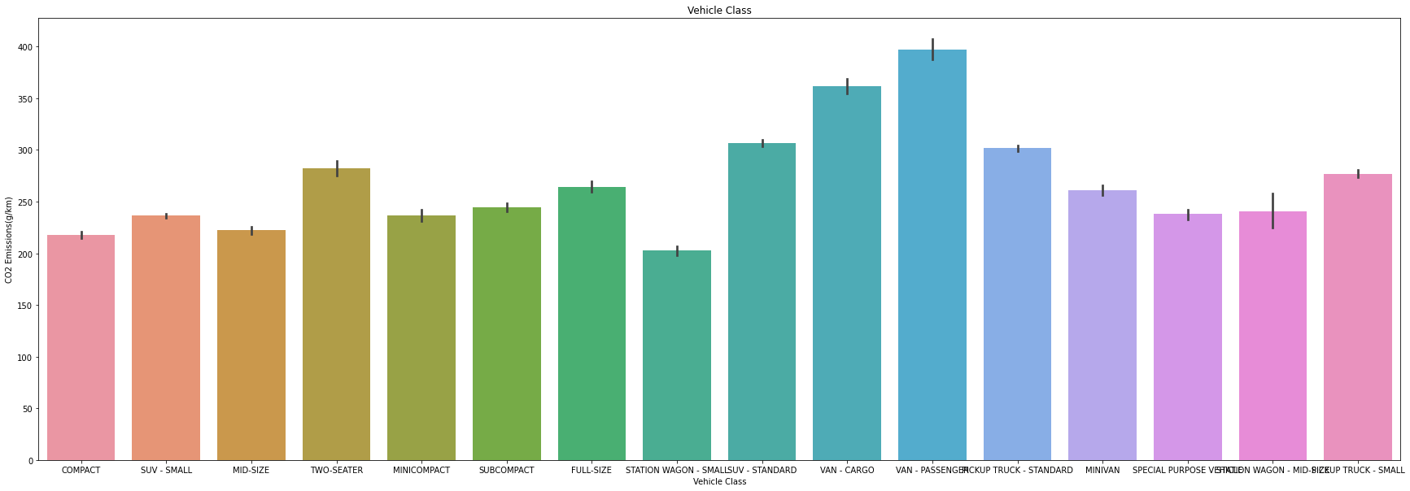

Slide 39
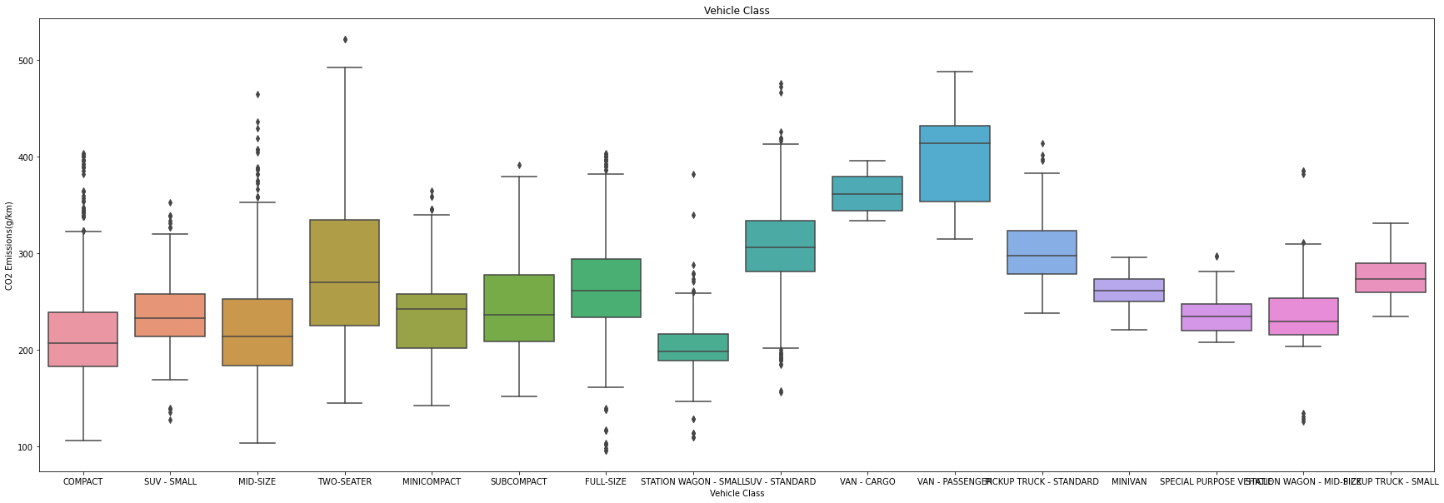

Slide 40
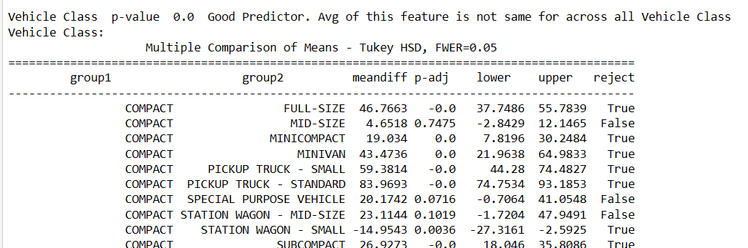

Slide 41
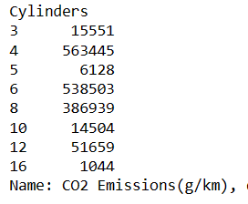
Total Co2 Emission by Cylinders

Slide 42
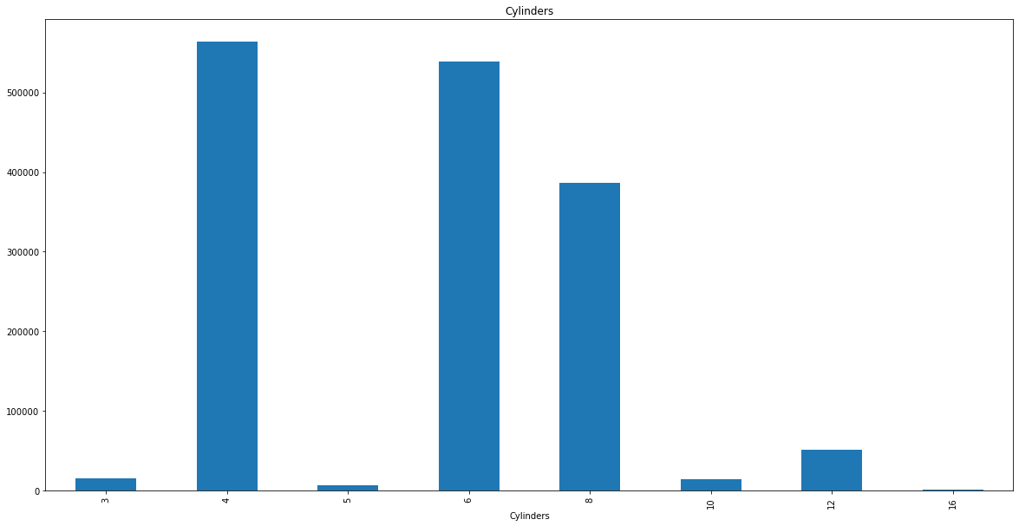

Slide 43
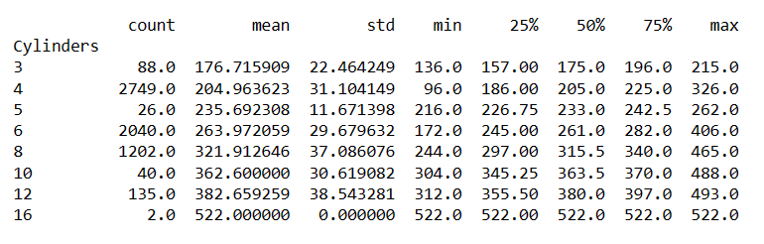

Slide 44
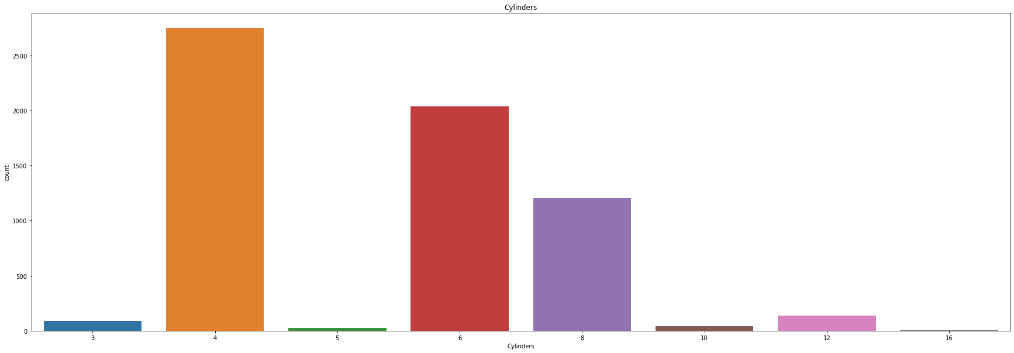

Slide 45
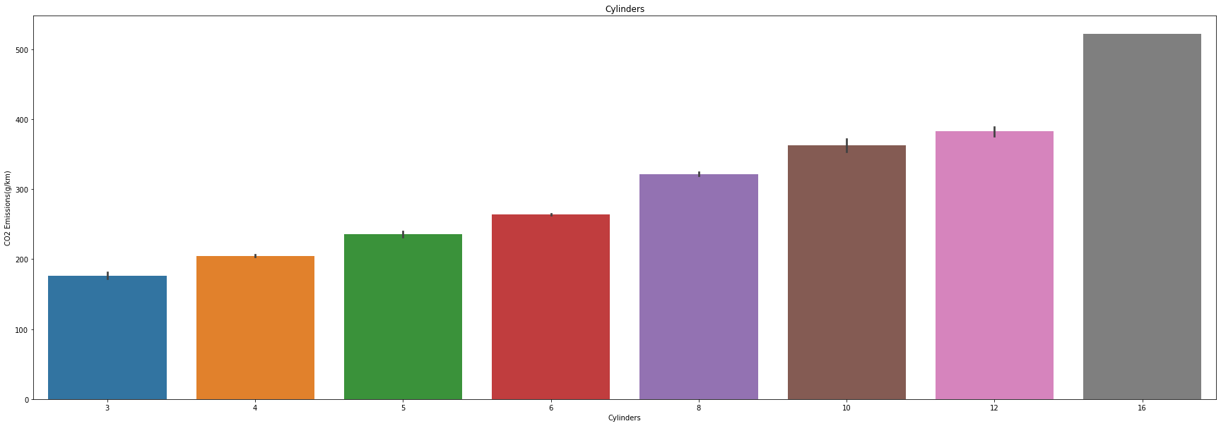

Slide 46
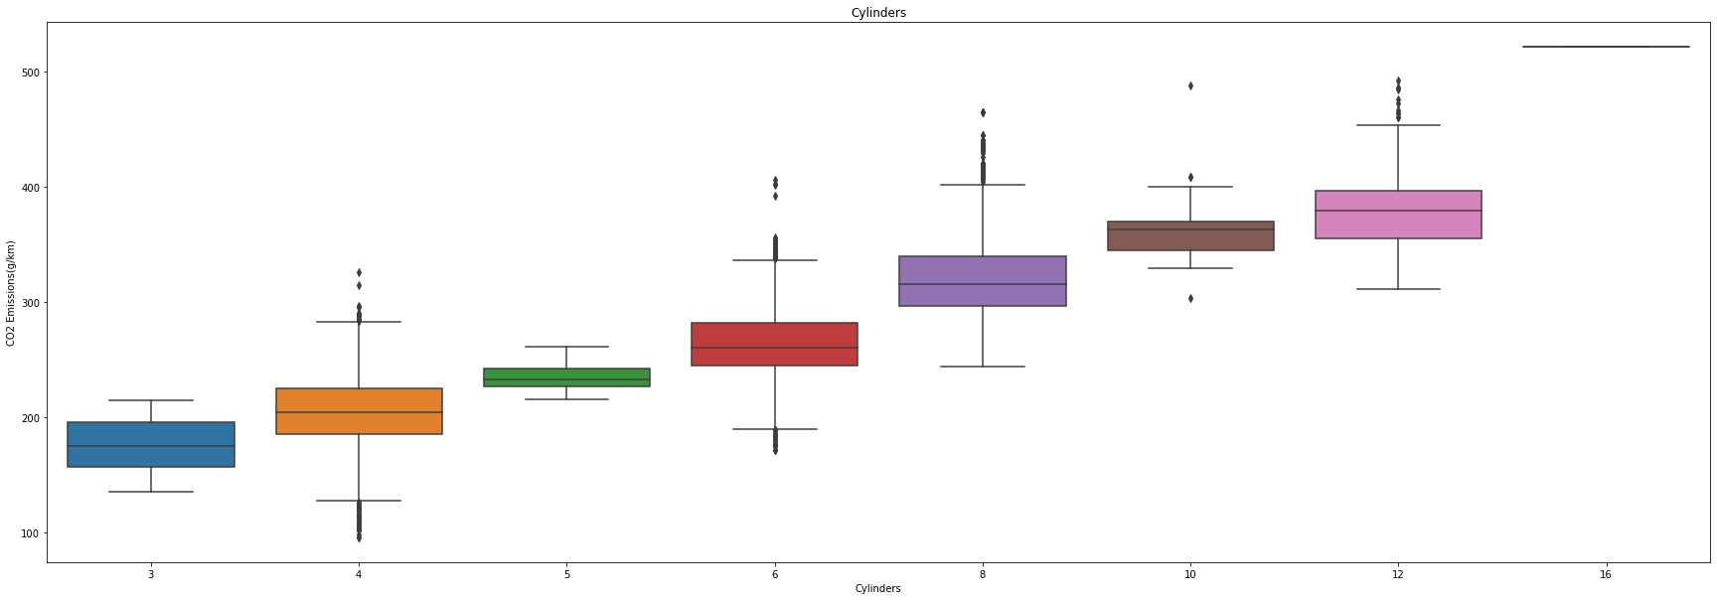

Slide 47
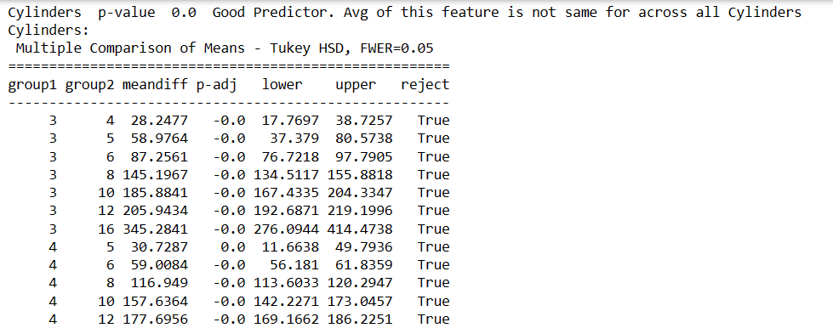

Slide 48
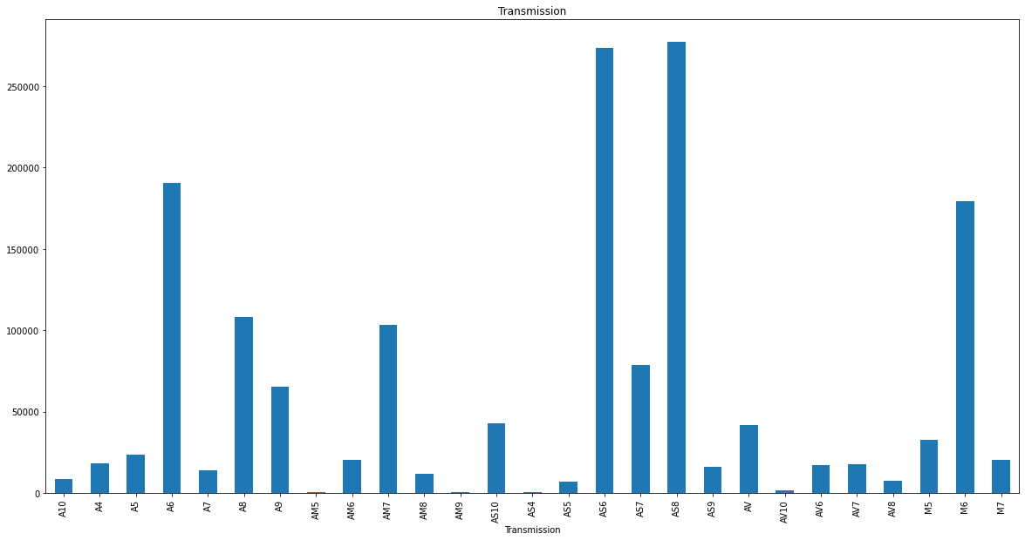
Total Co2 Emission by Transmission Type

Slide 49
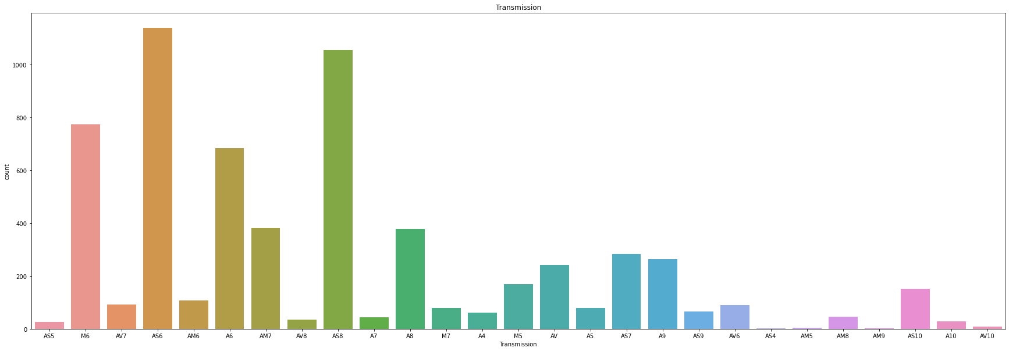

Slide 50


Slide 51


Slide 52
# Vehicle Class
# We can see that highest amount of Co2 is contributed by SUV Small and Std Vehicles along with Compact and Mid Size Cars.
# Significant amount of contribution comes from full-size vehicles, pick-up truck standard subcompact and two seater cars
# Interestingly, we can see count of SUV standard is not very high but contribution to Co2 Emission is quite high
# From the bargraph and boxplot we can see avg contribution to Co2 Emission by SUV- Std is quite high. Special Attention is required towards SUV-Std
# as count of SUV is significant but no very high but still it is one of the top contributors to Co2 Emission
# Cylinders
# We can see that highest amount of Co2 is contributed by 4 cylinders,followed by 6 cylinders and 8 cylinders
# The same pattern is followed in countplot. Special attention is required to improve 6 cylinders engines and count is significant
# but contributions to Co2 is almost same as 4 cylinders engines in total
# From the bargraph and boxplot we can see, avg contibution to Co2 Emission increases with number of cylinders
#Transmission
# Highest amount of contribution to Co2 Emission is by AS6 and AS8 type, followed by A6 and M6 type. Significant Contribution
# is also given by A8,AM7 and AS7
# Count of M6, AS6, A6, AS8 is also high. We can the Co2 Emission is more or less directly proportional to count.
# From Bargraph and Boxplot we can see the range of average Co2 Emission is small.
# AV7, AM6, M5, AV, AV6, AM5, AV10 avg Co2 Emission is less.

Slide 53
# Fuel_type
# Clearly X & Z fuel type have highest Co2 Emission in total.
# Again Co2 Emission in total is directly proportional to count. There is no anomally
# On an average Co2 Emission for all fuel type is same

Slide 54



Slide 55



Slide 56



Slide 57


Slide 58


Slide 59



Slide 60


Slide 61


Slide 62





Slide 63
Business Implication
This project will help the concerned authorities to look into the CO2 Emissions and direct the companies to which models need attention, which models can be discontinued and give a cap of to the companies how much Co2 emission can be allowed for different types of vehicle. Even report can be published based on this project so that environment concerned people are avoiding to buy more Co2 emitting vehicles.

